Slide 1

Aviation Extra Fuel Prediction Analysis
A deep analysis of predicting extra fuel in aviation using data and statistical approaches, including the development of a machine learning prediction model.

Slide 2

Data Acquisition & Methodology
Dataset Selection
The `US 2023 Civil Flights, delays, meteo and aircrafts` dataset from Kaggle was chosen due to its comprehensive flight and weather information, despite lacking direct fuel consumption data.
Feature Engineering: Estimated Fuel Consumption
To address the absence of direct fuel consumption data, a feature engineering approach was implemented:
Aircraft Type Lookup:
Tail numbers were used to identify aircraft models. Due to `openap` limitations with CRJ aircraft, an external lookup table of typical cruise fuel consumption rates was utilized.
Fuel Consumption Estimation:
Estimated distance (Haversine formula) and assumed cruise speed (850 km/h) were used to calculate estimated total fuel consumed (kg) for each flight.
Data Preprocessing and Sampling
A representative sample of 100,000 rows was extracted from the original 1.1 GB dataset to manage computational resources. Missing fuel consumption values (for unidentifiable aircraft) were dropped.
Dataset Splitting
The preprocessed data was split into Training (80%), Validation (10%), and Test (10%) sets. Initially, `Estimated_Distance_km` was used as the primary feature for model development.

Slide 3

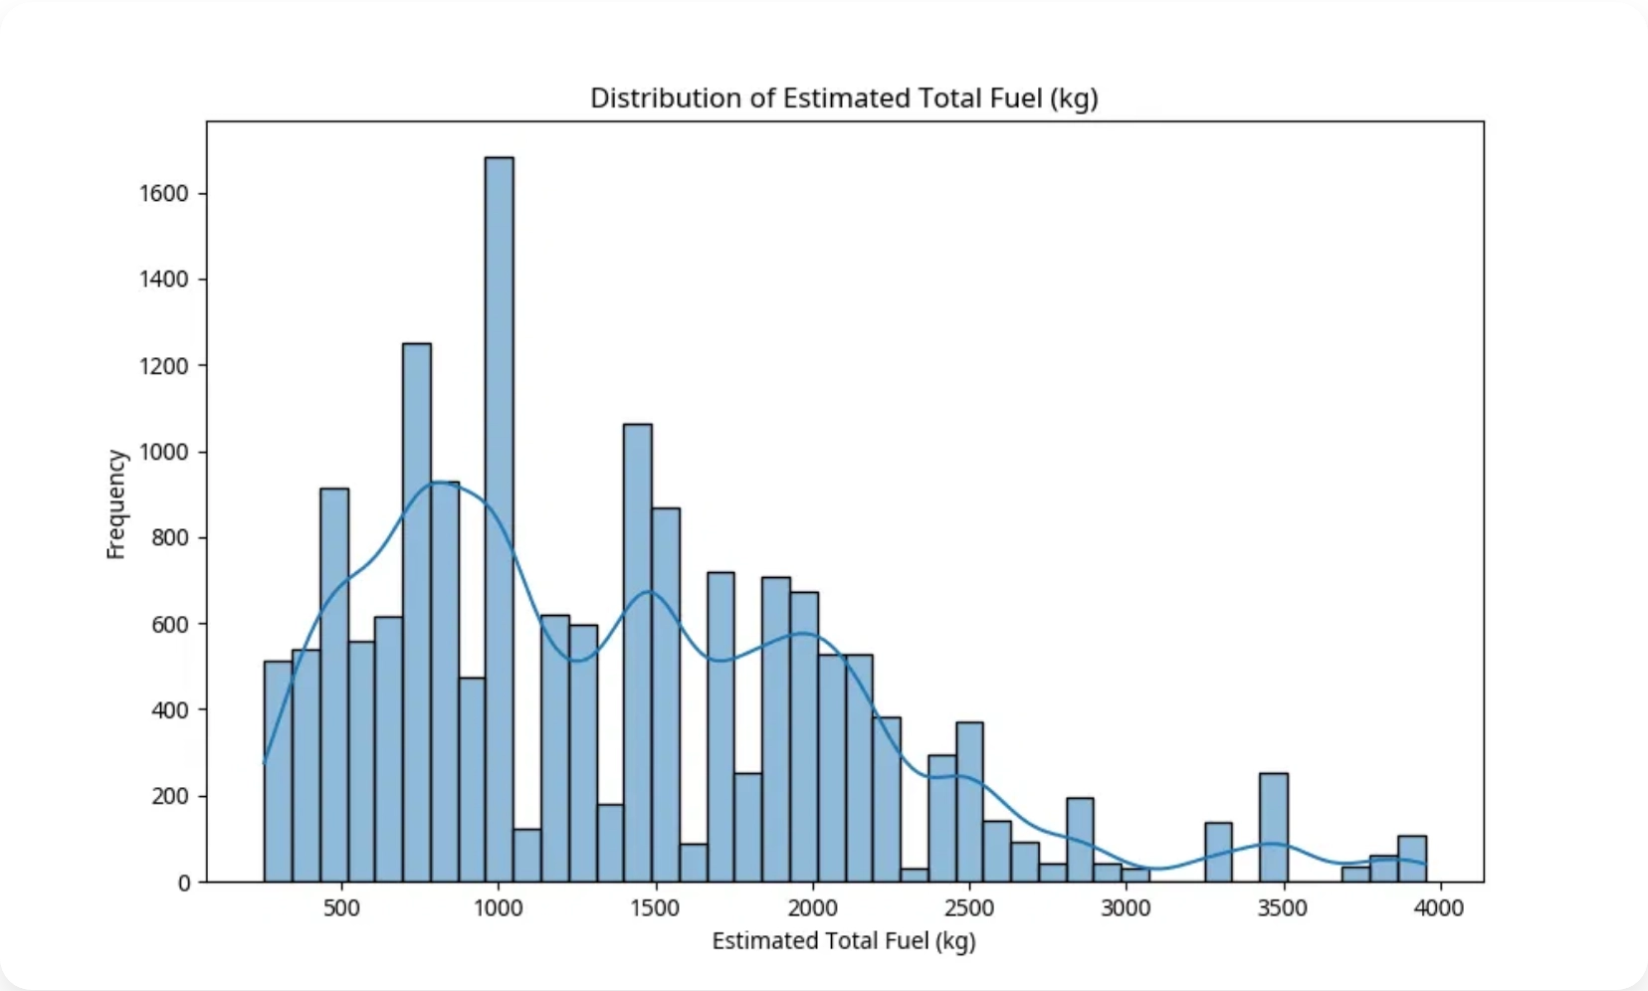
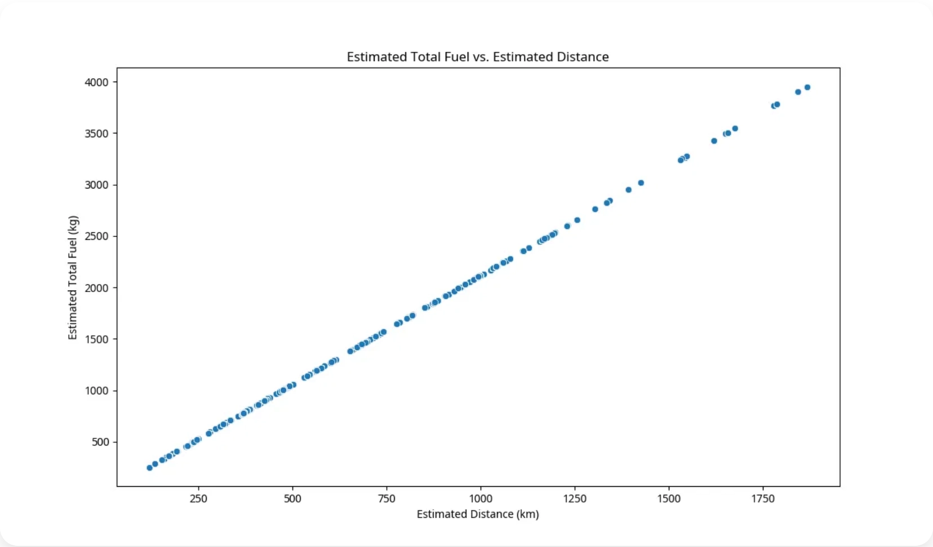
Exploratory Data Analysis (EDA)
EDA was conducted to understand data distributions, identify patterns, and visualize relationships within the augmented dataset.
Key Observations:
The distribution of estimated total fuel shows a concentration around lower values, reflecting shorter flights or lower fuel burn rates.
A strong, almost perfectly linear, positive correlation exists between estimated total fuel and estimated distance, validating the fuel estimation methodology.
Analysis of fuel consumption by aircraft type (top 10) revealed variations, highlighting the importance of aircraft-specific characteristics.

Slide 4

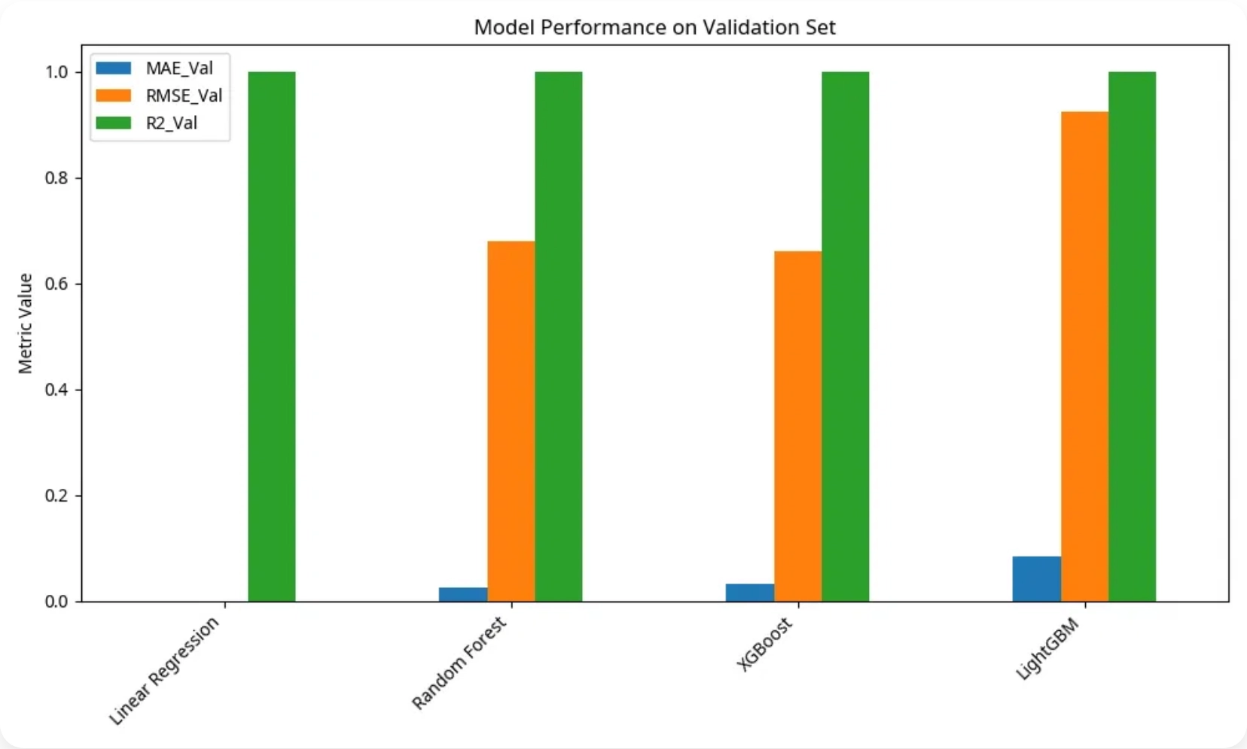
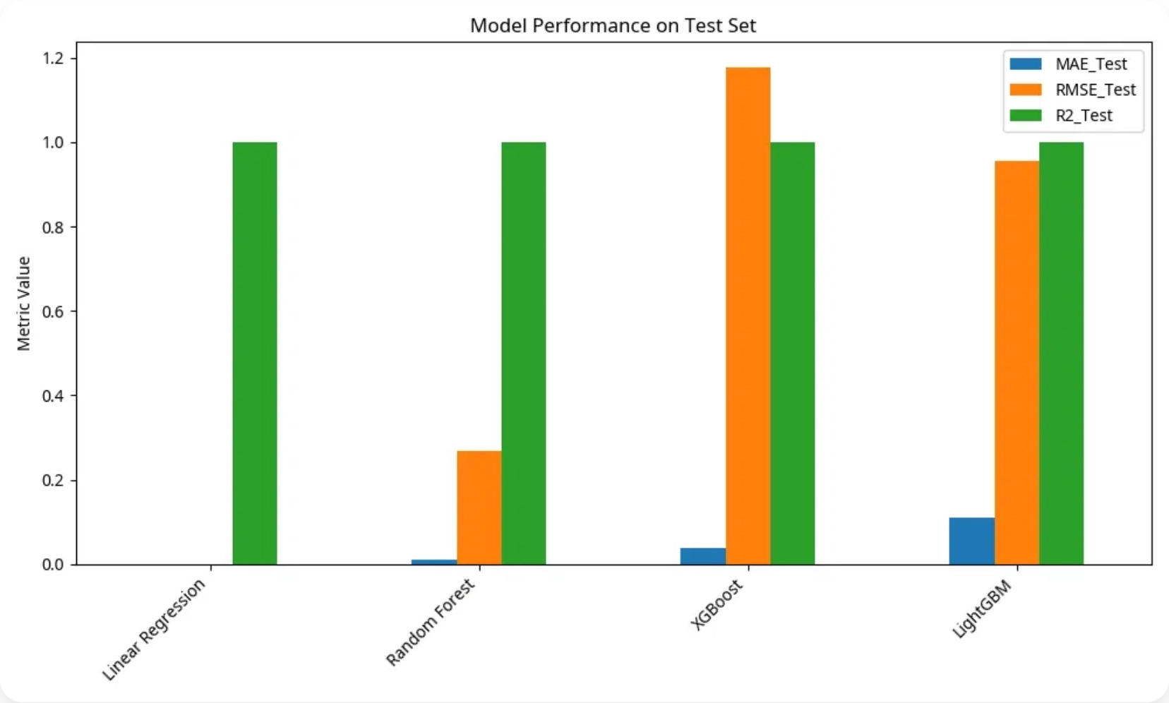
Machine Learning Model Development & Evaluation
Model Selection & Training
Regression models including Linear Regression, Random Forest, XGBoost, and LightGBM were trained on the dataset. For this initial phase, default hyperparameters were used.
Evaluation Metrics
Models were evaluated using Mean Absolute Error (MAE), Root Mean Squared Error (RMSE), and R-squared (R2) Score.
Performance Comparison
Model
MAE (Validation)
RMSE (Validation)
R2 (Validation)
MAE (Test)
RMSE (Test)
R2 (Test)
Linear Regression
0.00
0.00
1.00
0.00
0.00
1.00
Random Forest
0.03
0.68
1.00
0.01
0.27
1.00
XGBoost
0.03
0.66
1.00
0.04
1.18
1.00
LightGBM
0.08
0.92
1.00
0.11
0.96
1.00
Analysis:
All models achieved exceptionally high R2 scores and low errors. This is primarily due to the
strong linear relationship between the estimated fuel consumption and estimated distance, as the
target variable was derived from a deterministic formula. Linear Regression performed almost
perfectly, capturing this linearity effectively.

Slide 5

Conclusion & Future Work
Conclusion
This project successfully demonstrated a methodology for estimating aviation fuel consumption using publicly available flight data and external lookup tables. The developed machine learning models showed excellent performance in predicting the estimated total fuel consumption, largely due to the strong linear relationship between estimated distance and estimated fuel.
Limitations
The `Estimated_Total_Fuel_kg` is a synthetic target variable, derived from a simplified model of cruise fuel burn.
It does not account for real-world complexities like taxiing, take-off, climb, descent, holding patterns, or actual flight profiles.
Operational uncertainties (e.g., extra fuel due to weather, delays) are not directly captured in this estimated value.
Future Work
Integrate Weather Data:
Incorporate detailed weather data to understand its influence on actual fuel consumption.
Refine Fuel Consumption Estimation:
Explore more sophisticated methods for estimating baseline fuel consumption.
Define and Model 'Extra Fuel':
Shift focus to modeling "extra fuel" by predicting deviations from baseline due to operational factors.
Incorporate Operational Data:
Include air traffic control delays, runway conditions, and airline-specific policies.
Advanced Feature Engineering:
Create complex features like wind components and weather severity indices.
Model Interpretability:
Conduct in-depth interpretability analysis for complex models.
Deployment Considerations:
Explore options for deploying the predictive model as a service.

